Slide 1
Content
Last presentation review
Dual methods for solving the DP
Example: random walk problem (dual ascent approach)
Future lines (23/03/2017)
DANIEL GARCÍA-OCAÑA HERNÁNDEZ

Slide 2
Content
LAST PRESENTATION REVIEW
Dual methods for solving the DP
Example: random walk problem (dual ascent approach)
Future lines (23/03/2017)

Slide 3

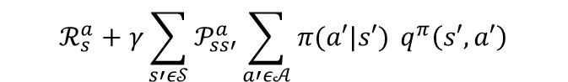
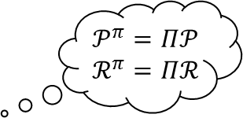
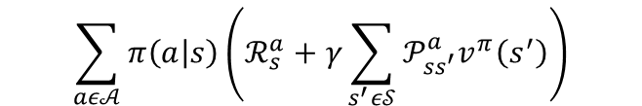
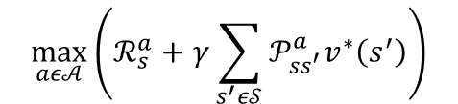


Bellman’s equations
$$𝒫^{π}=Π𝒫$$
$$ℛ^{π}=Πℛ$$
a
$v^{π}\left(s\right)=𝔼_{π,𝒫}\left[G_{t} | S_{t}=s, A_{t}\sim π\right]=𝔼_{π,𝒫}\left[R_{t+1}+γv^{π}(S_{t+1}) | S_{t}=s, A_{t+k}\sim π\right]=$
$$\sum_{aε𝒜}{π\left(a | s\right)\left(ℛ_{s}^{a}+γ\sum_{s^{′}ε𝒮}{𝒫_{ss^{′}}^{a}v^{π}\left(s^{′}\right)}\right)}$$
vector form
$$v^{π}=ℛ^{π}+γ𝒫^{π}v^{π}$$
$v^{∗}\left(s\right)=\max_{aε𝒜}{𝔼_{𝒫}\left[R_{t+1}+γv^{∗}(S_{t+1}) | S_{t}=s\right]}=$
$$\max_{aε𝒜}\left(ℛ_{s}^{a}+γ\sum_{s^{′}ε𝒮}{𝒫_{ss^{′}}^{a}v^{∗}\left(s^{′}\right)}\right)$$
$q^{π}\left(s,a\right)=𝔼_{π,𝒫}\left[G_{t} | S_{t}=s,A_{t}=a,A_{t+k}\sim π\right]=𝔼_{π,𝒫}\left[R_{t+1}+γq^{π}\left(S_{t+1},A_{t+1}\right) | S_{t}=s,A_{t}=a,A_{t+k}\sim π\right]=$
$$ℛ_{s}^{a}+γ\sum_{s′ε𝒮}{𝒫_{ss′}^{a}\sum_{a′ε𝒜}{π(a′|s′) }q^{π}\left(s′,a′\right)}$$
vector form
$$q^{π}=ℛ+γ𝒫Πq^{π}$$
$q^{∗}\left(s,a\right)=\max_{aε𝒜}{𝔼_{𝒫}\left[R_{t+1}+γq^{∗}(S_{t+1},A_{t+1}) | S_{t}=s,A_{t}=a\right]}=$
$$ℛ_{s}^{a}+γ\sum_{s′ε𝒮}{𝒫_{ss′}^{a}\max_{a′ε𝒜}{ q}^{∗}\left(s′,a′\right)}$$
Notes:
3.23, 24, 28 y 29
transition probability matrix and the expected reward vector for policy all possible deterministic policies (3.42 y 3.43)
La óptima sigue una greedy policy (3.56)

Slide 4


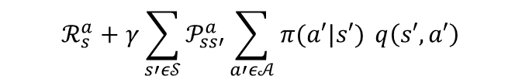
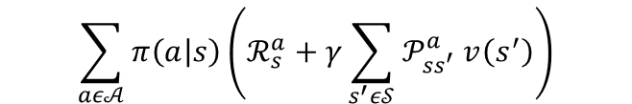

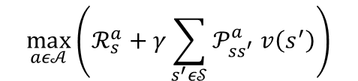


Bellman’s operator: definition
a
$\left(T_{π}v\right)\left(s\right)≜𝔼_{π,𝒫}\left[R_{t+1}+γv(S_{t+1}) | S_{t}=s, A_{t+k}\sim π\right]=$
$$\sum_{aε𝒜}{π\left(a | s\right)\left(ℛ_{s}^{a}+γ\sum_{s^{′}ε𝒮}{𝒫_{ss^{′}}^{a} v\left(s^{′}\right)}\right)}$$
vector form
$$T_{π}v$$
$(Tv)\left(s\right)≜\max_{aε𝒜}{𝔼_{𝒫}\left[R_{t+1}+γv(S_{t+1}) | S_{t}=s\right]}=$
$$\max_{aε𝒜}\left(ℛ_{s}^{a}+γ\sum_{s^{′}ε𝒮}{𝒫_{ss^{′}}^{a} v\left(s^{′}\right)}\right)$$
vector form
$$Tv$$
$\left(T_{π}q\right)\left(s,a\right)≜𝔼_{π,𝒫}\left[R_{t+1}+γq\left(S_{t+1},A_{t+1}\right) | S_{t}=s,A_{t}=a,A_{t+k}\sim π\right]=$
$$ℛ_{s}^{a}+γ\sum_{s′ε𝒮}{𝒫_{ss′}^{a}\sum_{a′ε𝒜}{π(a′|s′) }q\left(s′,a′\right)}$$
vector form
$$T_{π}q$$
$(Tq)\left(s,a\right)≜\max_{aε𝒜}{𝔼_{𝒫}\left[R_{t+1}+γq(S_{t+1},A_{t+1}) | S_{t}=s,A_{t}=a\right]}=$
$$ℛ_{s}^{a}+γ\sum_{s′ε𝒮}{𝒫_{ss′}^{a}\max_{a′ε𝒜} q\left(s′,a′\right)}$$
vector form
$$Tq$$
Notes:
Lío con la notación!!
A shorthand notation → notación taquigráfica
Mapping que transforma la función de v a S en una función de Tv a S (FUNCIONAL)

Slide 5
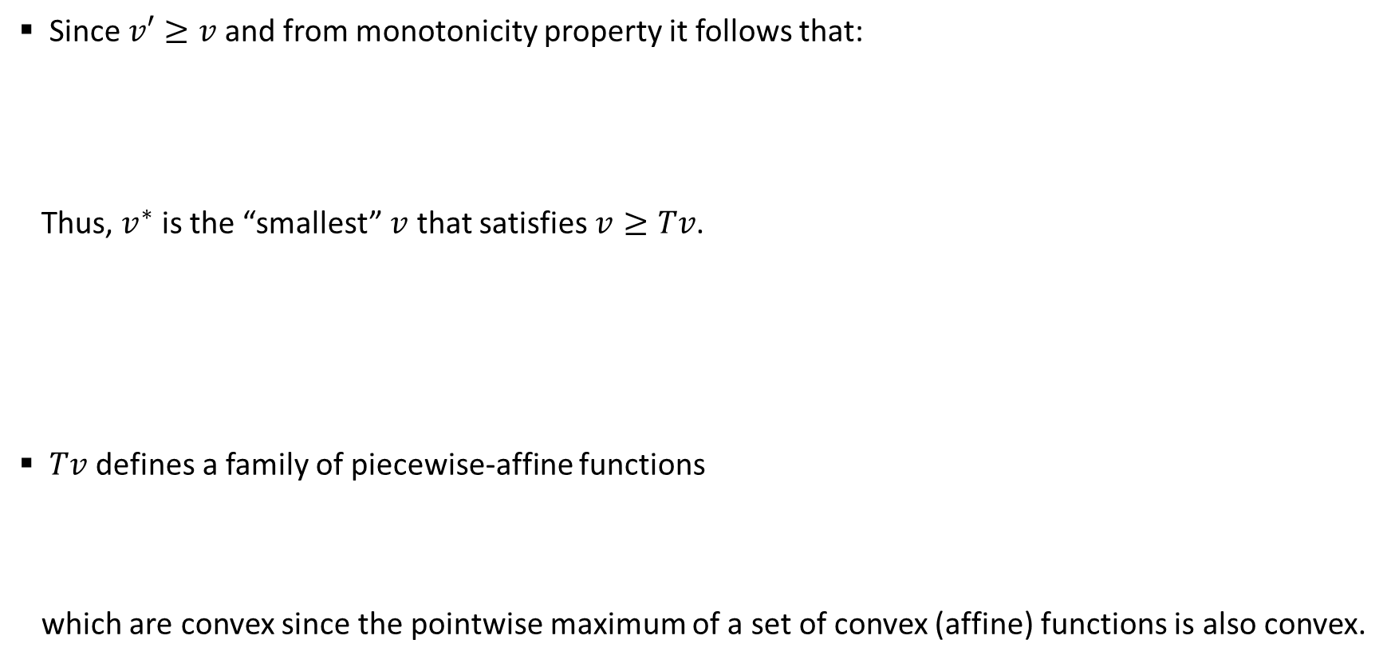
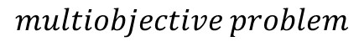
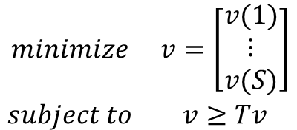
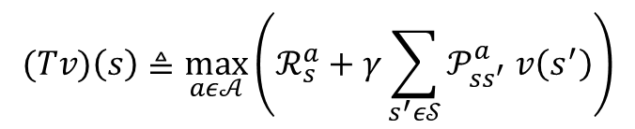
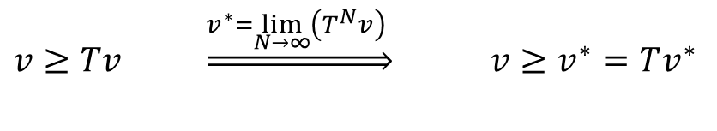
DP formulation as an LP (I)
Since$v′≥v$ and from monotonicity property it follows that:
Thus, $v^{∗}$ is the “smallest” $v$ that satisfies $v≥Tv$.
$Tv$ defines a family of piecewise-affine functions
which are convex since the pointwise maximum of a set of convex (affine) functions is also convex.
Optimal cost function condition
$v≥Tv \underset{⇒}{v^{∗}=\lim_{N→∞}\left(T^{N}v\right) }$ ${v≥v}^{∗}=Tv^{∗}$
$$\begin{matrix}minimize & v=\left[\begin{matrix}v(1) \\ \begin{matrix}⋮ \\ v(S)\end{matrix}\end{matrix}\right] \\ subject to & v≥Tv\end{matrix}$$
$$multiobjective problem$$
$$(Tv)\left(s\right)≜\max_{aε𝒜}\left(ℛ_{s}^{a}+γ\sum_{s^{′}ε𝒮}{𝒫_{ss^{′}}^{a} v\left(s^{′}\right)}\right)$$
Notes:
Multiobjective = vector optimization problem

Slide 6
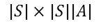
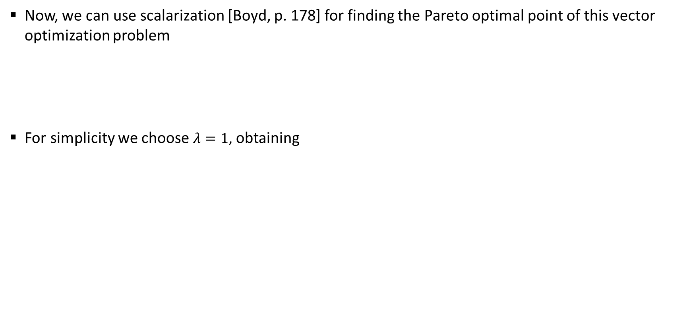
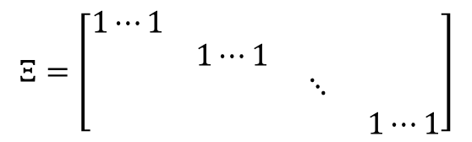

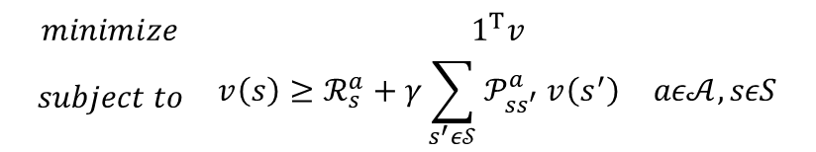
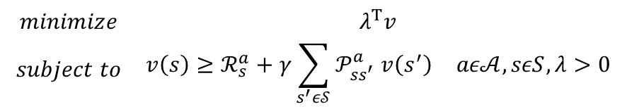
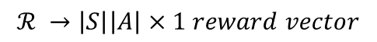
DP formulation as an LP (II)
Now, we can use scalarization [Boyd, p. 178] for finding the Pareto optimal point of this vector optimization problem
For simplicity we choose $λ=1$, obtaining
$$\begin{matrix}minimize & λ^{T}v \\ subject to & \begin{matrix}{v\left(s\right)≥ℛ}_{s}^{a}+γ\sum_{s^{′}ε𝒮}{𝒫_{ss^{′}}^{a} v\left(s^{′}\right)} & aε𝒜,sεS,λ>0\end{matrix}\end{matrix}$$
DP formulation as an LP
$$\begin{matrix}minimize & 1^{T}v \\ subject to & \begin{matrix}{v\left(s\right)≥ℛ}_{s}^{a}+γ\sum_{s^{′}ε𝒮}{𝒫_{ss^{′}}^{a} v\left(s^{′}\right)} & aε𝒜,sεS\end{matrix}\end{matrix}$$
vector form
$$\begin{matrix}minimize & 1^{T}v \\ subject to & Ξ^{T}v≥{ℛ+γ𝒫v} \end{matrix}$$
$$ℛ →\left|S\right|\left|A\right|×1 reward vector$$
$$Ξ=\left[\begin{matrix}1⋯1 & \begin{matrix}1⋯1 & 11 & 1⋯1\end{matrix} \\ \begin{matrix}1⋯1 \\ \begin{matrix}1⋯1 \\ 1⋯1\end{matrix}\end{matrix} & \begin{matrix}\begin{matrix}1⋯1 \\ \begin{matrix}1⋯1 \\ 1⋯1\end{matrix}\end{matrix} & \begin{matrix}\begin{matrix}11 & 1⋯1\end{matrix} \\ \begin{matrix}\begin{matrix}⋱ & 1⋯1\end{matrix} \\ \begin{matrix}11 & 1⋯1\end{matrix}\end{matrix}\end{matrix}\end{matrix}\end{matrix}\right]$$
$$𝒫 →\left|S\right|\left|A\right|×\left|S\right| transition matrix$$
$$|S|×|S||A|$$
$$v →\left|S\right|×1 state value function vector$$
Notes:
Multiobjective = vector optimization problem

Slide 7
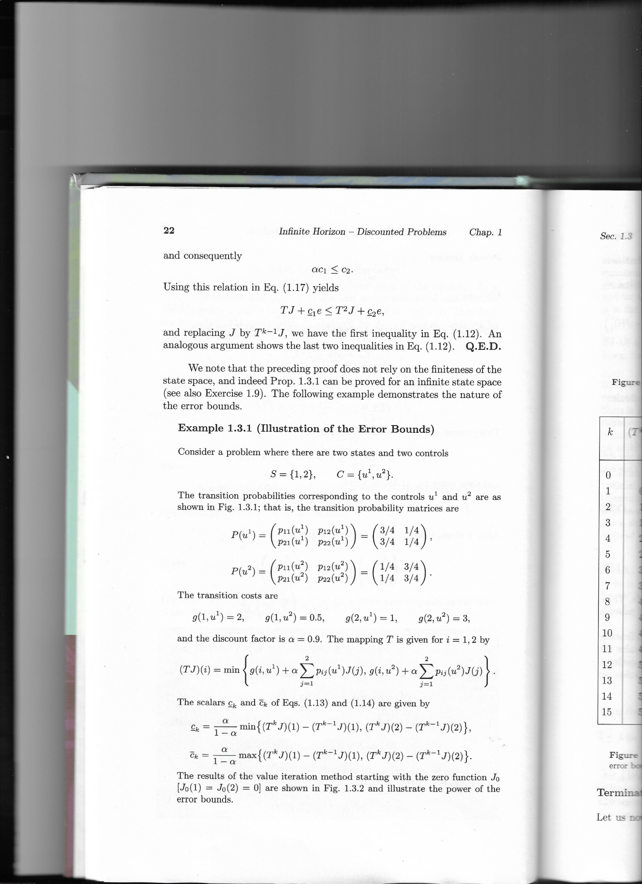

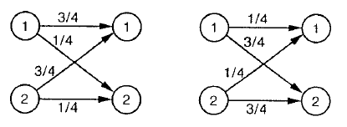
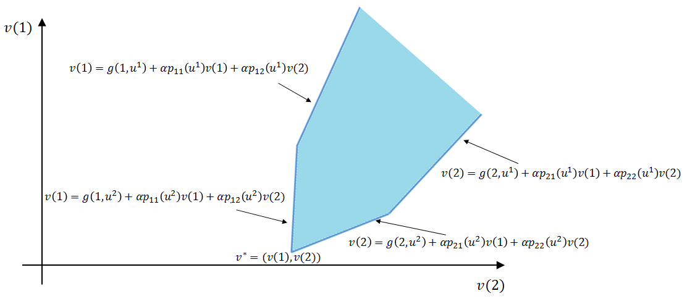
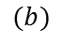
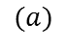
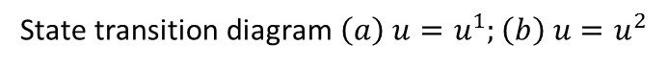
DP formulation as an LP (IV)
In order to summar
$$(a)$$
$$(b)$$
State transition diagram $\left(a\right) u=u^{1};\left(b\right) u=u^{2}$
Notes:
El state transition diagram muestra las transition probabilities corresponding to the controls u1 and u2

Slide 8
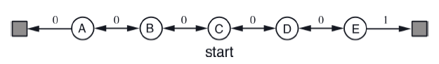
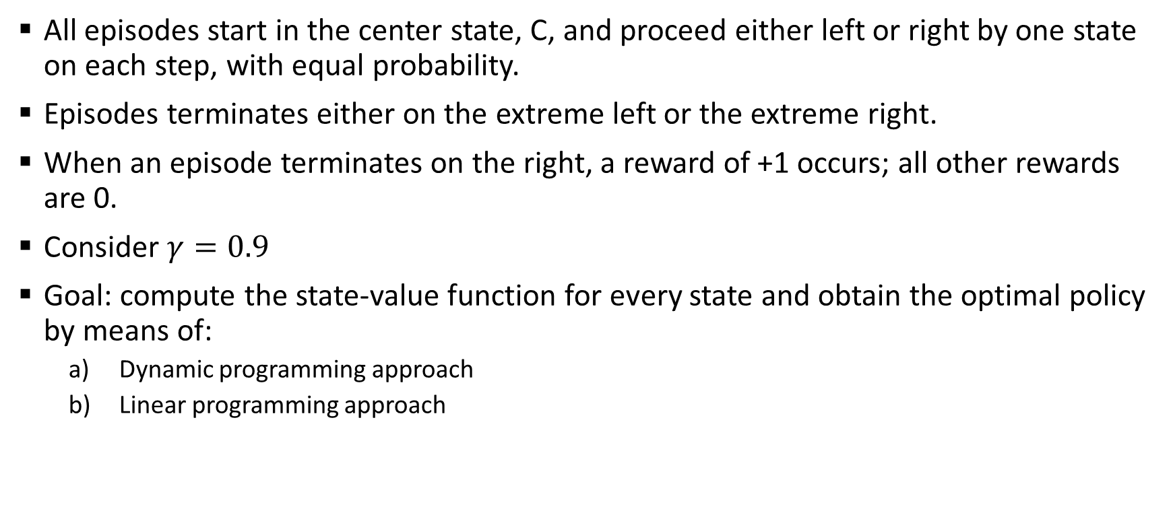
Example: random walk problem
All episodes start in the center state, C, and proceed either left or right by one state on each step, with equal probability.
Episodes terminates either on the extreme left or the extreme right.
When an episode terminates on the right, a reward of +1 occurs; all other rewards are 0.
Consider $γ=0.9$
Goal: compute the state-value function for every state and obtain the optimal policy by means of:
Dynamic programming approach
Linear programming approach
T1
T2

Slide 9
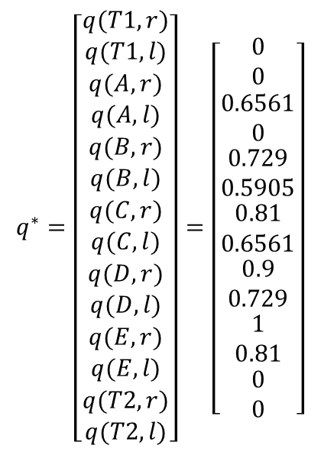
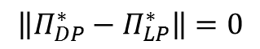
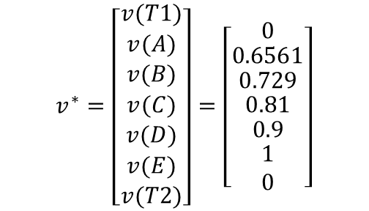
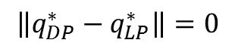
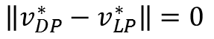
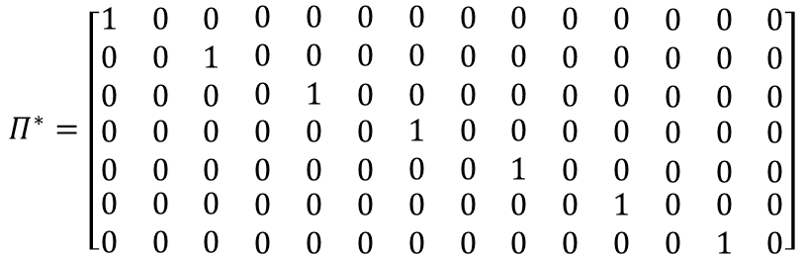
Example: random walk problem (LP)
Solving the LP random walk problem by CVX → we obtained the same results as solving with value iteration
$$q^{∗}=\left[\begin{matrix}\begin{aligned}q(T1,r) \\ q(T1,l)\end{aligned} \\ \begin{matrix}\begin{aligned}q(A,r) \\ q(A,l)\end{aligned} \\ \begin{matrix}\begin{aligned}q(B,r) \\ q(B,l)\end{aligned} \\ \begin{matrix}\begin{aligned}q(C,r) \\ q(C,l)\end{aligned} \\ \begin{matrix}\begin{aligned}q(D,r) \\ q(D,l)\end{aligned} \\ \begin{matrix}\begin{aligned}q(E,r) \\ q(E,l)\end{aligned} \\ \begin{aligned}q(T2,r) \\ q(T2,l)\end{aligned}\end{matrix}\end{matrix}\end{matrix}\end{matrix}\end{matrix}\end{matrix}\right]=\left[\begin{matrix}\begin{aligned}0 \\ 0\end{aligned} \\ \begin{matrix}\begin{aligned}0.6561 \\ 0\end{aligned} \\ \begin{matrix}\begin{aligned}0.729 \\ 0.5905\end{aligned} \\ \begin{matrix}\begin{aligned}0.81 \\ 0.6561\end{aligned} \\ \begin{matrix}\begin{aligned}0.9 \\ 0.729\end{aligned} \\ \begin{matrix}\begin{aligned}1 \\ 0.81\end{aligned} \\ \begin{aligned}0 \\ 0\end{aligned}\end{matrix}\end{matrix}\end{matrix}\end{matrix}\end{matrix}\end{matrix}\right]$$
$$v^{∗}=\left[\begin{matrix}v(T1) \\ \begin{matrix}v(A) \\ \begin{matrix}v(B) \\ \begin{matrix}v(C) \\ \begin{matrix}v(D) \\ \begin{matrix}v(E) \\ v(T2)\end{matrix}\end{matrix}\end{matrix}\end{matrix}\end{matrix}\end{matrix}\right]=\left[\begin{matrix}0 \\ \begin{matrix}0.6561 \\ \begin{matrix}0.729 \\ \begin{matrix}0.81 \\ \begin{matrix}0.9 \\ \begin{matrix}1 \\ 0\end{matrix}\end{matrix}\end{matrix}\end{matrix}\end{matrix}\end{matrix}\right]$$
$$Π^{∗}=\left[\begin{matrix}\begin{matrix}1 & 0 & 0 \\ 0 & 0 & 1 \\ 0 & 0 & 0\end{matrix} & \begin{matrix}0 & 0 & \begin{matrix}0 & 0 & \begin{matrix}0 & 0 & \begin{matrix}0 & 0 & \begin{matrix}0 & 0 & 0\end{matrix}\end{matrix}\end{matrix}\end{matrix} \\ 0 & 0 & \begin{matrix}0 & 0 & \begin{matrix}0 & 0 & \begin{matrix}0 & 0 & \begin{matrix}0 & 0 & 0\end{matrix}\end{matrix}\end{matrix}\end{matrix} \\ 0 & 1 & \begin{matrix}0 & 0 & \begin{matrix}0 & 0 & \begin{matrix}0 & 0 & \begin{matrix}0 & 0 & 0\end{matrix}\end{matrix}\end{matrix}\end{matrix}\end{matrix} \\ \begin{matrix}0 & 0 & 0 \\ 0 & 0 & 0 \\ \begin{matrix}0 \\ 0\end{matrix} & \begin{matrix}0 \\ 0\end{matrix} & \begin{matrix}0 \\ 0\end{matrix}\end{matrix} & \begin{matrix}\begin{matrix}0 & 0 & 0\end{matrix} & 1 & \begin{matrix}0 & 0 & \begin{matrix}0 & 0 & \begin{matrix}0 & 0 & 0\end{matrix}\end{matrix}\end{matrix} \\ \begin{matrix}0 & 0 & 0\end{matrix} & 0 & \begin{matrix}0 & 1 & \begin{matrix}0 & 0 & \begin{matrix}0 & 0 & 0\end{matrix}\end{matrix}\end{matrix} \\ \begin{matrix}\begin{matrix}0 \\ 0\end{matrix} & \begin{matrix}0 \\ 0\end{matrix} & \begin{matrix}0 \\ 0\end{matrix}\end{matrix} & \begin{matrix}0 \\ 0\end{matrix} & \begin{matrix}\begin{matrix}0 \\ 0\end{matrix} & \begin{matrix}0 \\ 0\end{matrix} & \begin{matrix}\begin{matrix}0 \\ 0\end{matrix} & \begin{matrix}1 \\ 0\end{matrix} & \begin{matrix}\begin{matrix}0 \\ 0\end{matrix} & \begin{matrix}0 \\ 1\end{matrix} & \begin{matrix}0 \\ 0\end{matrix}\end{matrix}\end{matrix}\end{matrix}\end{matrix}\end{matrix}\right]$$
$$\left\|v_{DP}^{∗}−v_{LP}^{∗}\right\|=0$$
$$\left\|q_{DP}^{∗}−q_{LP}^{∗}\right\|=0$$
$$\left\|Π_{DP}^{∗}−Π_{LP}^{∗}\right\|=0$$

Slide 10
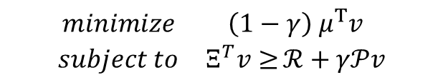
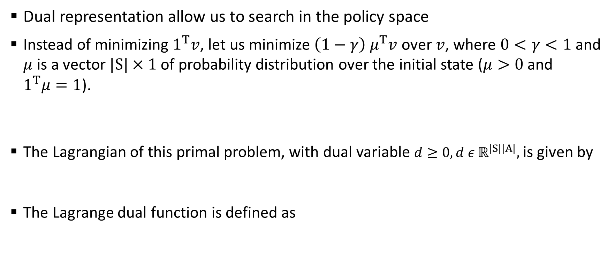
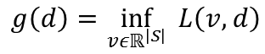
Dual representation of the LP approach (I)
Dual representation allow us to search in the policy space
Instead of minimizing $1^{T}v$, let us minimize $\left(1−γ\right) μ^{T}v$ over $v$, where $0<γ<1$ and $μ$ is a vector $|S|×1$ of probability distribution over the initial state ($μ>0$ and $1^{T}μ=1$).
The Lagrangian of this primal problem, with dual variable $d≥0, d ε ℝ^{\left|S\right|\left|A\right|},$ is given by
The Lagrange dual function is defined as
$$\begin{matrix}minimize & \left(1−γ\right) μ^{T}v \\ subject to & Ξ^{T}v≥{ℛ+γ𝒫v}\end{matrix}$$
$$L\left(v,d\right)=\left(1−γ\right) μ^{T}v+d^{T}(ℛ+γ𝒫v−Ξ^{T}v)$$
$$g\left(d\right)=\inf_{v{εℝ}^{\left|S\right|}}{ L\left(v,d\right)}$$

Slide 11
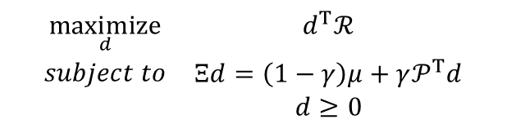
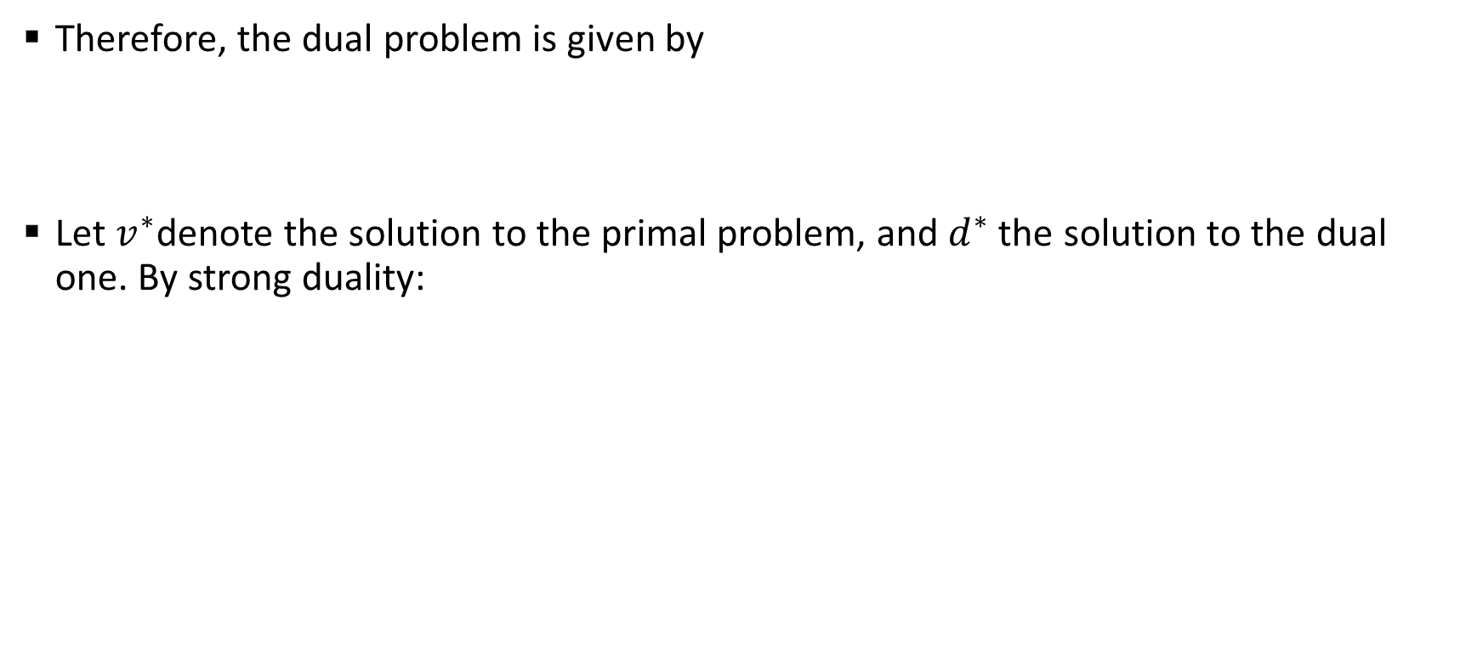
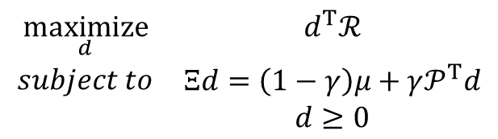
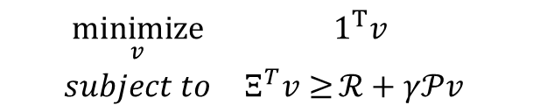
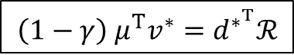
Dual representation of the LP approach (II)
Therefore, the dual problem is given by
Let $v^{∗}$denote the solution to the primal problem, and $d^{∗}$ the solution to the dual one. By strong duality:
$$\begin{matrix}\underset{d}{maximize} & d^{T}ℛ \\ \begin{aligned}subject to \\ \end{aligned} & \begin{matrix}Ξd=\left(1−γ\right)μ+γ𝒫^{T}d \\ d≥0\end{matrix}\end{matrix}$$
$$\begin{matrix}\underset{v}{minimize} & 1^{T}v \\ subject to & Ξ^{T}v≥{ℛ+γ𝒫v} \end{matrix}$$
$$\begin{matrix}\underset{d}{maximize} & d^{T}ℛ \\ \begin{aligned}subject to \\ \end{aligned} & \begin{matrix}Ξd=\left(1−γ\right)μ+γ𝒫^{T}d \\ d≥0\end{matrix}\end{matrix}$$
PRIMAL PROBLEM
DUAL PROBLEM
$$\left(1−γ\right) μ^{T}v^{∗}=d^{∗^{T}}ℛ$$
STRONG DUALITY

Slide 12
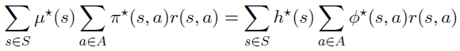
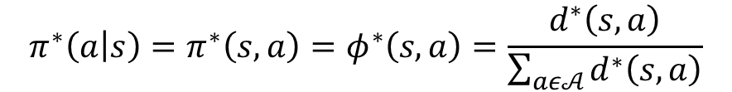
Why using dual representation? (III)
Using the two unrolls and the strong duality condition, we have
We conclude that we can obtain the optimal policy from the optimal dual variable
$$π^{∗}\left(a | s\right)=π^{∗}\left(s,a\right)=φ^{∗}\left(s,a\right)=\frac{d^{∗}\left(s,a\right)}{\sum_{aε𝒜}{d^{∗}\left(s,a\right)}}$$
While the primal linear problem searches the optimal value, the dual formulation searches in the policy space

Slide 13
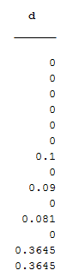
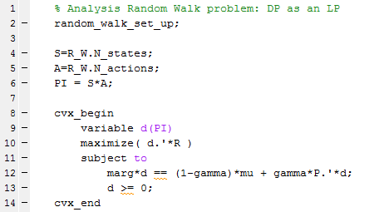
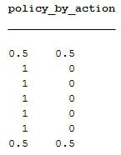

Example: random walk problem (cont.)
Solving the dual problem we obtain the same results as the primal and value iteration
$$π^{∗}\left(a | s\right)=\frac{d^{∗}\left(s,a\right)}{\sum_{aε𝒜}{d^{∗}\left(s,a\right)}}$$
a1 = right
a2 = left

Slide 14
Content
Last presentation review
DUAL METHODS FOR SOLVING THE DP
Example: random walk problem (dual ascent approach)
Future lines (23/03/2017)

Slide 15
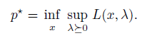
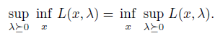
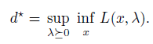
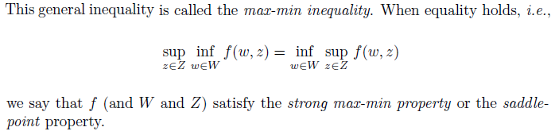
Dual methods for solving the DP: saddle point (I)
By strong duality, we can express:
The order of the minimization over x and the maximization over λ>0 can be switched without affecting the result

Slide 16
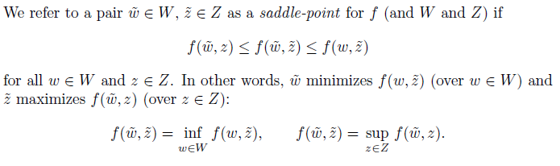

Dual methods for solving the DP: saddle point (II)
A
Returning to our discussion of Lagrange duality, we see that if $x^{∗}$ and $λ^{∗}$ are primal and dual optimal points for a problem in which strong duality obtains, they form a saddle-point for the Lagrangian.

Slide 17





Dual methods for solving the DP: saddle point (III)
Possibility of doing an stochastic gradient → Arrow-Hurwicz algorithm
To generate approximate solutions to problem (3), we consider a subgradient method motivated by Arrow-Hurwicz algorithm. The method has the following form:
$P_{M}$ the projection over the set M, in this case the set of positive number

Slide 18






Dual methods for solving the DP: saddle point (IV)
Lagrangian of primal problem
Lagrangian of dual problem
$$\begin{matrix}minimize & \left(1−γ\right) μ^{T}v \\ subject to & Ξ^{T}v≥{ℛ+γ𝒫v}\end{matrix}$$
$$v_{k+1}=v_{k}−α_{v}∇_{v}L\left(v,d\right)$$
$$d_{k+1}=d_{k}+α_{d}∇_{d}L\left(v,d\right)$$
$$if d_{k+1}<0 →d_{k+1}=0$$
$$L\left(v,d\right)=\left(1−γ\right) μ^{T}v+d^{T}(ℛ+γ𝒫v−Ξ^{T}v)$$
$$\begin{matrix}\underset{d}{maximize} & d^{T}ℛ \\ \begin{aligned}subject to \\ \end{aligned} & \begin{matrix}Ξd=\left(1−γ\right)μ+γ𝒫^{T}d \\ d≥0\end{matrix}\end{matrix}$$
$$d_{k+1}=d_{k}−α_{d}∇_{d}L\left(d,g,λ\right)$$
$$λ_{k+1}=λ_{k}+α_{λ}∇_{λ}L\left(d,g,λ\right)$$
$$if d_{k+1}<0 →d_{k+1}=0$$
$$L\left(d,g,λ\right)=d^{T}ℛ −g^{T}d+λ^{T}[\left(1−γ\right) μ^{T}+γ𝒫^{T}d−Ξd]$$

Slide 19
Dual methods for solving the DP: saddle point (V)
Both solutions highly oscillating. Never convergence was reached.
Tried the equivalent problem with CVX when v/d fixed and neither convergence was reached.
New suggestion: DUAL ASCENT

Slide 20




Dual methods for solving the DP: dual ascent (I)
$$\begin{matrix}minimize & \left(1−γ\right) μ^{T}v \\ subject to & Ξ^{T}v≥{ℛ+γ𝒫v}\end{matrix}$$
$$L\left(v,d\right)=\left(1−γ\right) μ^{T}v+d^{T}(ℛ+γ𝒫v−Ξ^{T}v)$$
$$v_{k+1}=\min_{v}{L\left(v,d\right)}$$
$$d_{k+1}=d_{k}+α_{d}∇_{d}L\left(v,d\right)$$
[http://www.math.ucla.edu/~wotaoyin/summer2013/slides/Lec07_Dual_Methods_part_1.pdf]

Slide 21




Dual methods for solving the DP: dual ascent (II)
$$v_{k+1}=\min_{v}{L\left(v,d\right)}$$
$$d_{k+1}=d_{k}+α_{d}∇_{d}L\left(v,d\right)$$
Both minimization methods showed convergence
Better using temporal difference (TD) → suitable for gradient descent
Exact solution method
¡Policy extracted from d!
$$v_{k+1}={\left(I−γΠP\right)}^{−1}ΠR$$
$$∇_{d}L\left(v,d\right)=ℛ+γ𝒫v−Ξ^{T}v$$
$$\min_{v}{L\left(v,d\right)}=$$
Iterative method (TD)

Slide 22
Content
Last presentation review
Dual methods for solving the DP
EXAMPLE: RANDOM WALK PROBLEM (DUAL ASCENT APPROACH)
Future lines (23/03/2017)

Slide 23

Example: random walk problem (dual ascent)
Modified versión
Nstates/2 states with random reward between 1 and 3. Last state on the right more reward, 20, to assure convergence.
Nstates parametrizable
Random transition matrix (i.e: when action is “left”, you go left with 0.6-1 probability and right with $1−p_{left}$ probability)
T1
T2

Slide 24
Example: random walk problem (dual ascent)

Slide 25
Content
Last presentation review
Dual methods for solving the DP
Example: random walk problem (dual ascent approach)
FUTURE LINES (23/03/2017)

Slide 26
Future lines (23/03/2017)
The milestones for next meeting are…
Fix/check the algorithm
Verify dual ascent theory
Propose a modified saddle point formulation
Review policy gradient theory

